Slide 1
Immersive JS Functions
with Dan DiGangi | Startup Institute Summer 2016

Slide 2







Front End Dev
JS Engineer
FE Architect
UX/UI Designer
@dandigangi

Slide 3
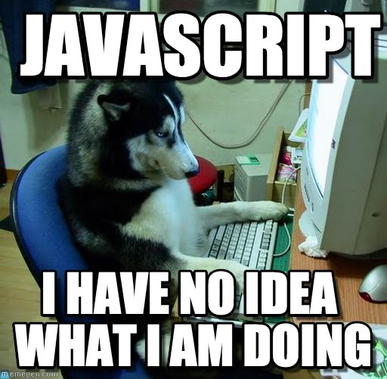
How are things so far?

Slide 4

Please ask questions

Slide 5


Meet your new best friends

Slide 6
WARNING

Slide 7
What We’re Learning
Objects
Arrays
Loops
Parameters
Functions
Goal: <3 Javascript

Slide 8
Objects & Arrays
Used as “storage blocks” for objects and primitives in JS.
Allow for layers of interactive functionality.
Unlike primitives (like a string or number), it can hold many “blocks”.

Slide 9
Objects
Storage for
Key/Value Pairs

Slide 10
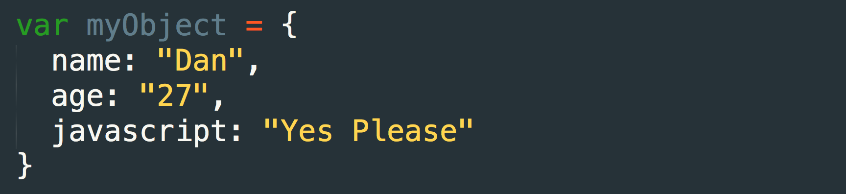
Objects
Stores Anything & Everything
KEY
VALUE

Slide 11
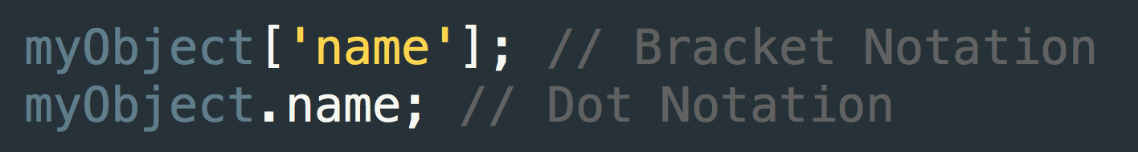
Accessing Objects
KEY REFERENCES

Slide 12
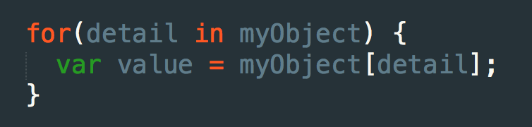
Looping Over Objects
Iterated Child
Parent Object

Slide 13
Arrays
Lists of “Blocks”

Slide 14
Arrays
Note: Arrays can store any & ALL “blocks”
VALUE

Slide 15
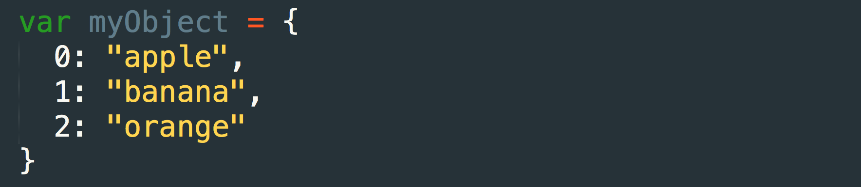
Understanding Arrays
Important!! Start counting from 0, not 1!
INDEX
VALUE

Slide 16
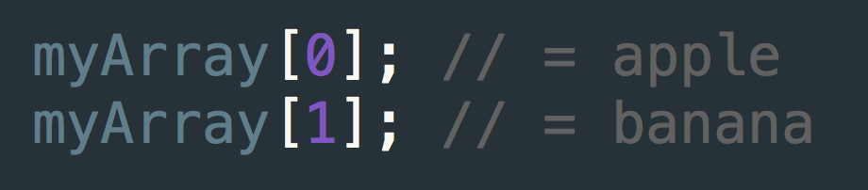
Accessing Arrays

Slide 17
Functions
Repeatable blocks of code

Slide 18
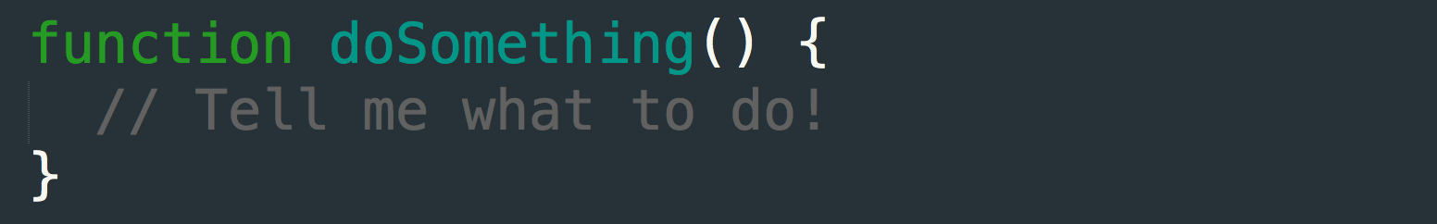
Functions (aka methods)
Define
Name
Instructions

Slide 19
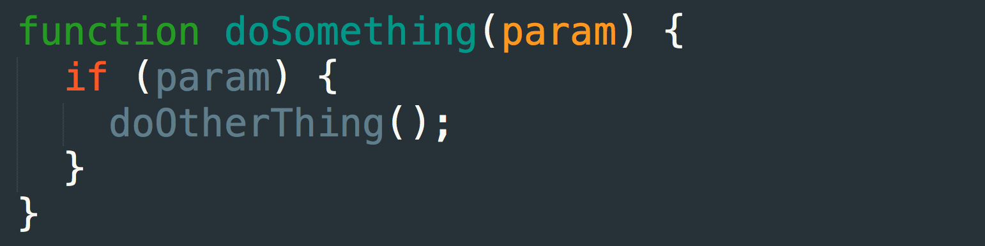
Passing Parameters to Functions
Passed into function
Used internally

Slide 20
Questions?

